Slide 1



Title: Fake News Detector
Submitted By: Muskaan (2022a6tr054)
Semester: 7th
Department: CSE(AI/ML)
Model Institute of
Engineering & Technology

Slide 2
Introduction
Fake news has emerged as one of the most pressing challenges of the digital era, often crafted to manipulate public opinion or provoke strong emotional reactions.
With the rapid proliferation of information across digital and social media platforms, distinguishing factual content from misinformation has become increasingly difficult. The sheer volume of online content renders manual fact-checking both slow and impractical at scale.
This project leverages Machine Learning (ML) and Natural Language Processing (NLP) to automatically detect fake news through textual analysis. The objective is to provide a fast, scalable, and accurate approach to combating misinformation, thereby promoting informed decision-making and digital trust.

Slide 3
Problem Statement
In today’s fast-paced digital era, misinformation and fake news often spread more rapidly than the truth, eroding public trust and shaping opinions in harmful ways.
Traditional human-led fact-checking, while valuable, cannot match the speed and volume of modern information flows.
This project proposes the development of an automated, intelligent detection system that harnesses Machine Learning to identify fake news by analyzing linguistic patterns and content structures. The goal is to create a scalable, accurate, and timely solution to counter the growing threat of misinformation.

Slide 4
Idea Behind the Problem
Fake news and real news sometimes have different tones, word choices, and writing styles.
Fake news may use sensationalized and emotional or misleading language.
These patterns can be captured and analyzed using Natural Language Processing (NLP).
If we train machine learning models on sufficiently large datasets, we can start training systems to identify and classify pieces of news content.
In this sense, we are changing from searching for characteristics of good and bad news content manually to automatically, data-driven, and machine learning models.

Slide 5
Solution Offered
Dataset Used
Combined and labeled dataset containing thousands of real and fake news articles for training and testing.
Text Preprocessing Techniques
Lowercasing to standardize text
Punctuation removal to clean the data
Stopword removal to eliminate unimportant words
Stemming to reduce words to their root form
Feature Engineering
Applied TF-IDF (Term Frequency–Inverse Document Frequency) Vectorization to convert textual data into numerical format for model training.

Slide 6
Solution Offered
Machine Learning Models Trained
Logistic Regression
Decision Tree Classifier
Gradient Boosting Classifier
Random Forest Classifier
Performance Evaluation Metrics
Accuracy, Precision, Recall, F1-Score
Manual Testing Interface
Developed a basic interface to manually test the model with custom news inputs, allowing users to classify articles as Real or Fake.

Slide 7
Model Performance Comparison
Model | Class | Precision | Recall | F1-Score
Logistic Regression | 0 | 0.99 | 0.99 | 0.99
 | 1 | 0.98 | 0.99 | 0.99
Decision Tree Classifier | 0 | 0.99 | 0.99 | 0.99
 | 1 | 0.98 | 0.99 | 0.99
Random Forest Classifier | 0 | 0.99 | 0.99 | 0.99
 | 1 | 0.99 | 0.99 | 0.99
Gradient Boosting Classifier |  | 1.00 | 0.99 | 1.00
 | 1 | 0.99 | 1.00 | 1.00
Best Performing Model: Gradient Boosting Classifier outperformed others with perfect classification scores across all metrics.

Slide 8
Tech Stack Used
Programming Language: Python – used for data processing, modeling, and evaluation
Libraries & Frameworks
Pandas – data manipulation
NumPy – numerical operations
Matplotlib & Seaborn – data visualization
Scikit-learn – machine learning models and performance metrics
NLTK – natural language preprocessing
Joblib – model saving and loading
Machine Learning Models
Logistic Regression
Decision Tree Classifier
Random Forest Classifier
Gradient Boosting Classifier
Tools
Jupyter Notebook – for interactive coding and analysis
CSV Files – used for dataset input/output
TF-IDF Vectorizer – to convert text data into numeric features
Streamlit – for building a user-friendly web interface allowing real-time testing of news articles as fake or real

Slide 9
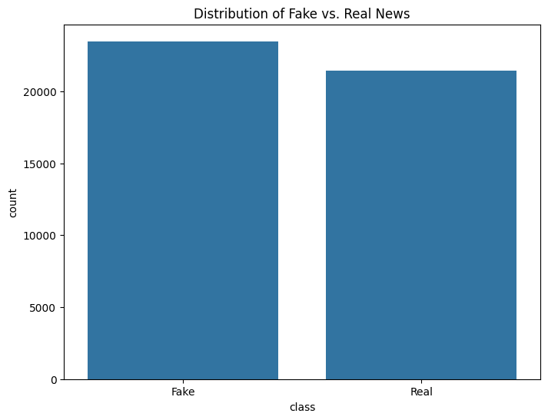
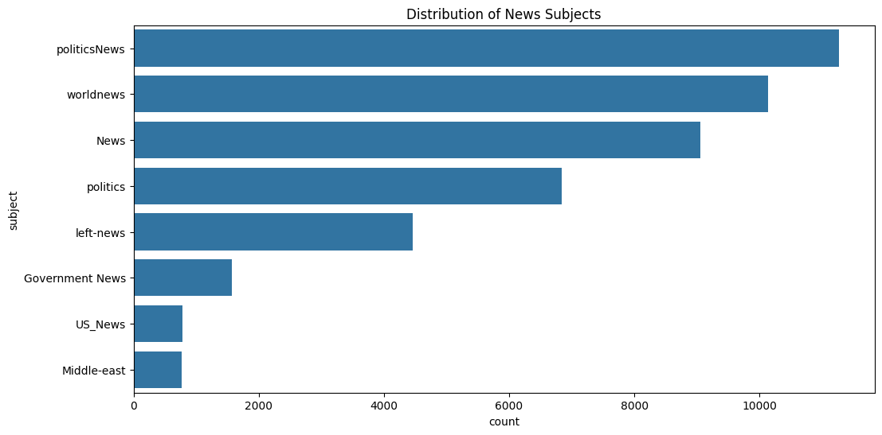
Outputs

Slide 10
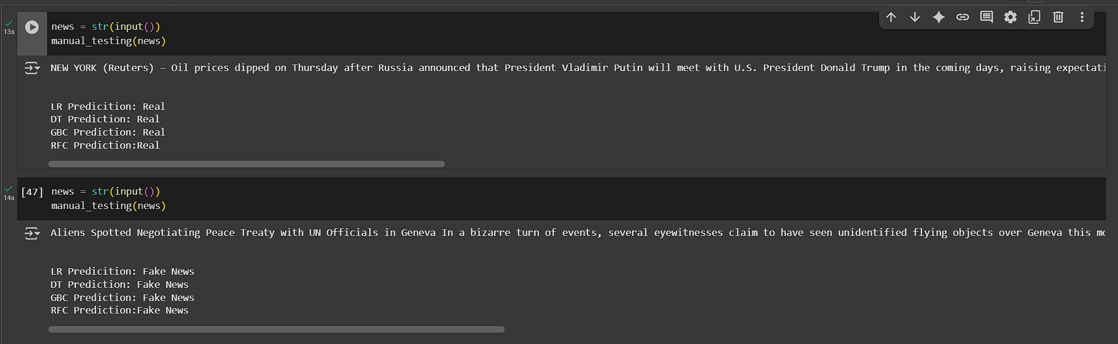
Manual Testing output

Slide 11
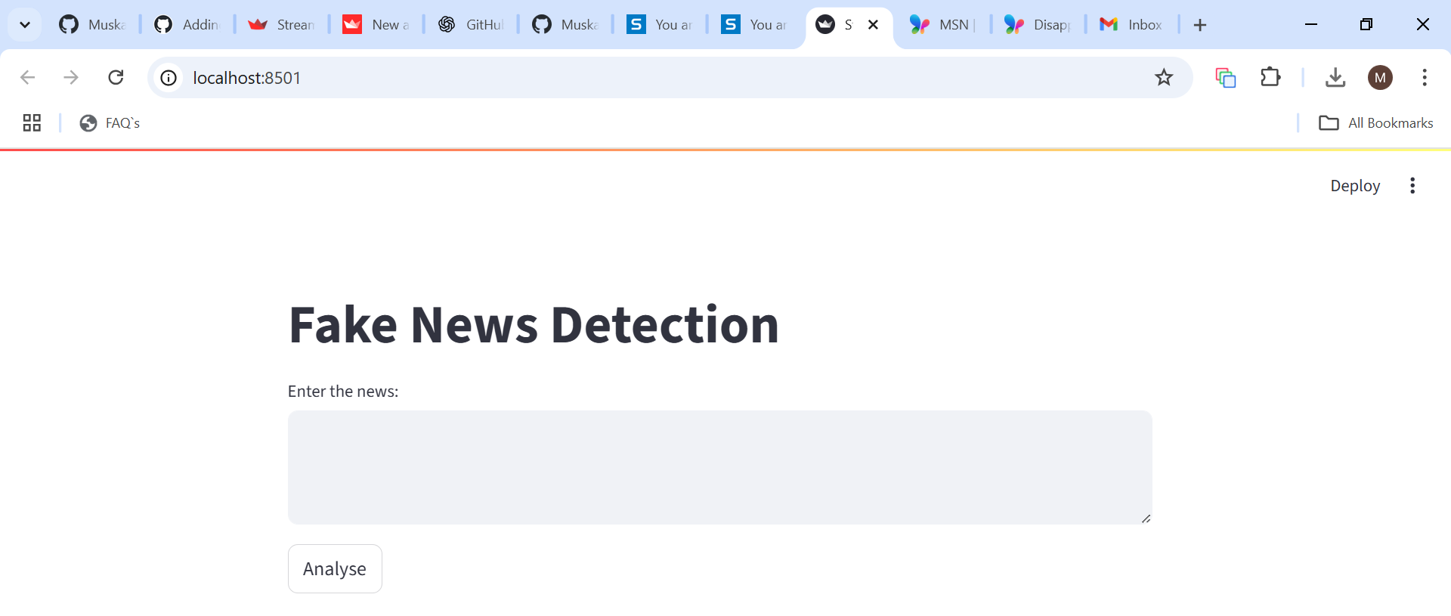
Interface Output

Slide 12
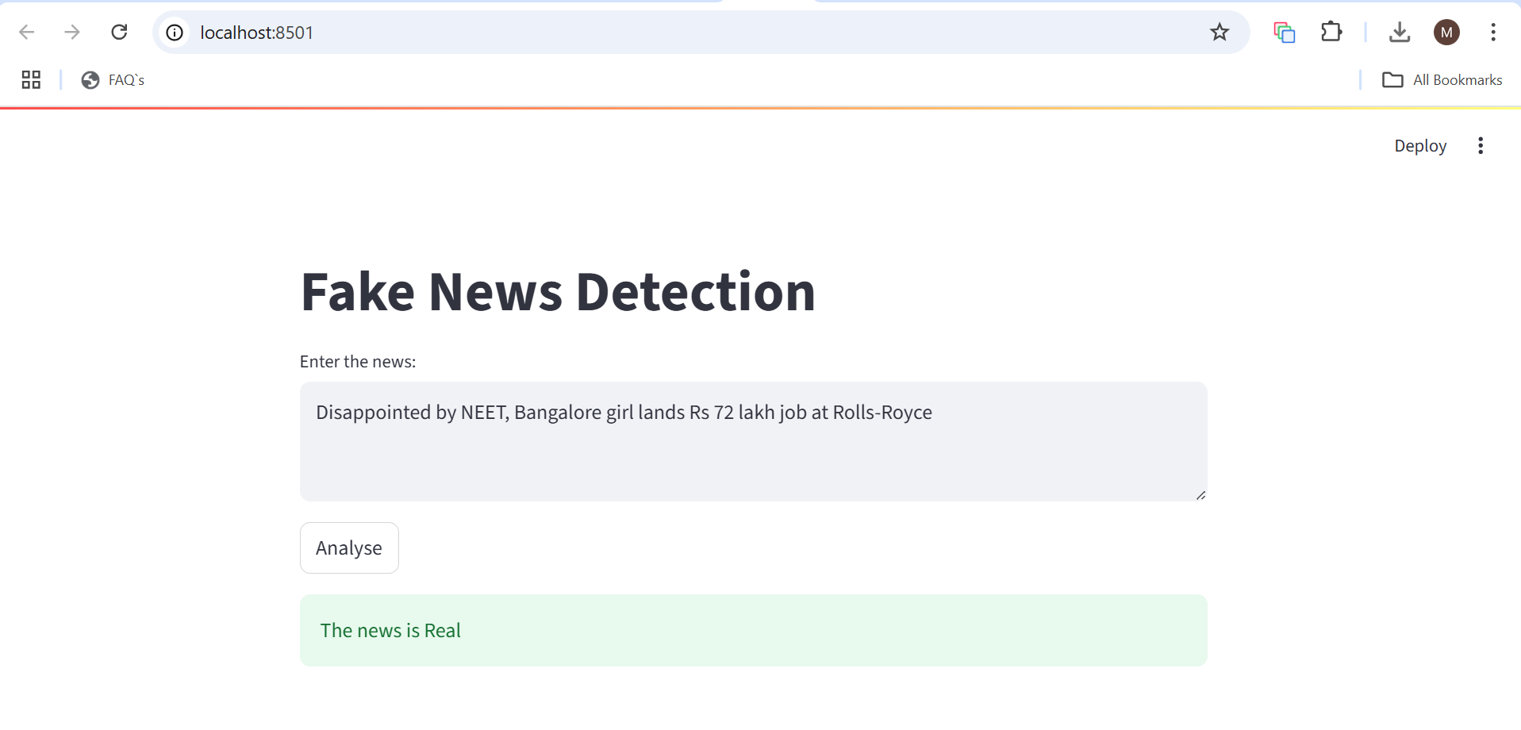
Interface Output

Slide 13
Further Enhancements
Integrate deep learning models like LSTM or BERT
Support detection in multiple languages
Enable real-time news or social media stream analysis
Improve Streamlit UI for better user experience
Add source credibility checks
Deploy as a web or mobile application

Slide 14
Conclusion
The spread of fake news has become a growing concern in the digital era, with serious implications for society. Traditional methods of identifying misinformation are no longer sufficient due to the volume and speed at which content is shared. This project demonstrates how Machine Learning and Natural Language Processing can be effectively used to detect fake news based on textual patterns. By training and evaluating multiple models, we achieved high accuracy and built a reliable system capable of identifying misinformation. The solution is fast, scalable, and serves as a strong foundation for combating fake news in real-time environments.

Slide 15

Thank You

